Slide 1

Azure Fundamentals
UNIT- 2
Azure Services

Slide 2
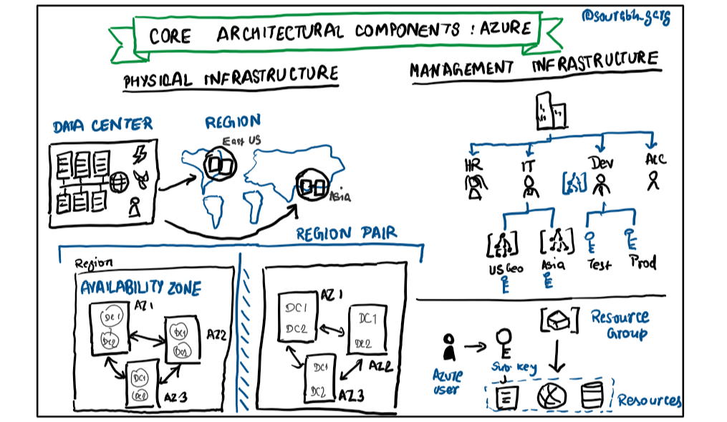
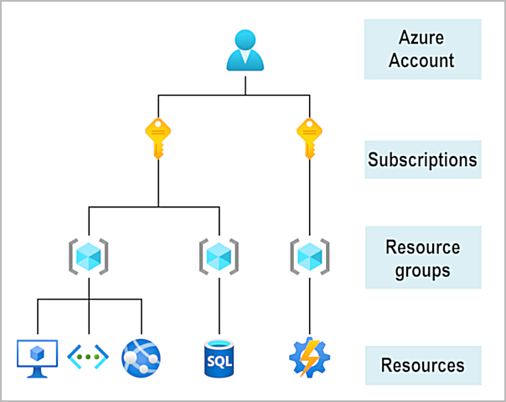
Architectural Components in Azure
What are the architectural components of Azure?
https://miro.medium.com/v2/resize:fit:1015/1*74Bq7_0PwxrF7GZb48nS1A.png
https://imgur.com/jEoLDBr.png

Slide 3
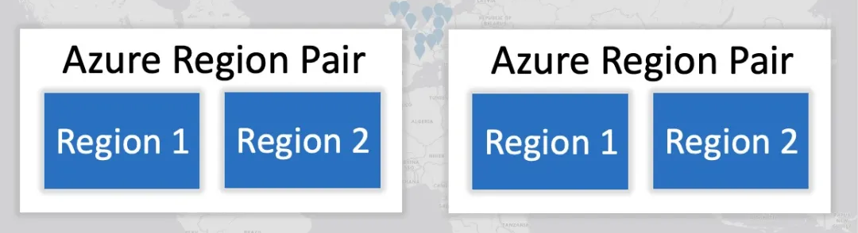
Architectural Components in Azure
What is Azure Region and Region Pair?
https://i0.wp.com/build5nines.com/wp-content/uploads/2017/01/Azure_Region_Pairs_Explained_2.jpg?resize=1080%2C536&ssl=1
Points to Remember
Region and Region Pair
Region
Data Residency
Resource Deployment
Service Availability
Availability Zones
Region Pair
Disaster Recovery
Resiliency
Data Replication
Planned Maintenance

Slide 4
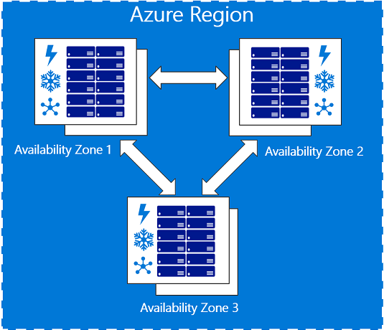
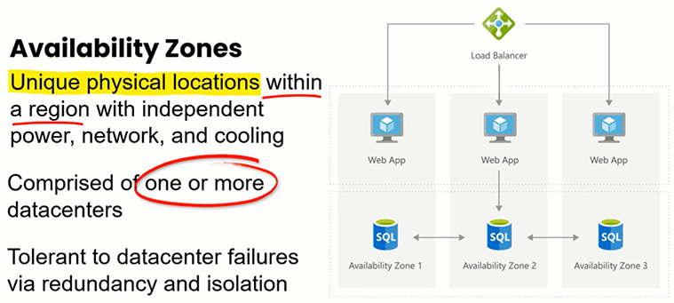
Architectural Components in Azure
What is Availability Zone?
https://azurecloudexpert.blob.core.windows.net/media/2018/01/az-graphic-two.png
https://vegibit.com/wp-content/uploads/2021/09/availability-zone-within-region.png

Slide 5
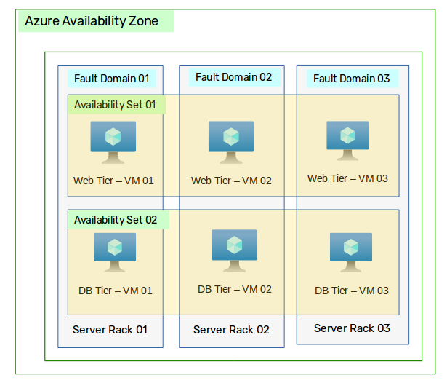
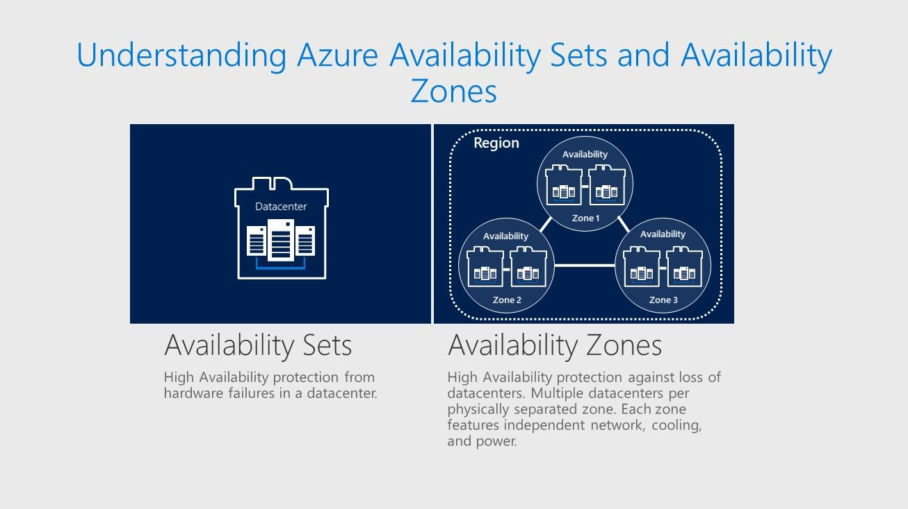
Architectural Components in Azure
What is Availability Set?
https://miro.medium.com/v2/resize:fit:615/1*Ws3lEMnV5qsN173z7ZoSEw.png
https://techcommunity.microsoft.com/t5/image/serverpage/image-id/241013iC5D14370B9D32810/image-size/original?v=v2&px=-1

Slide 6
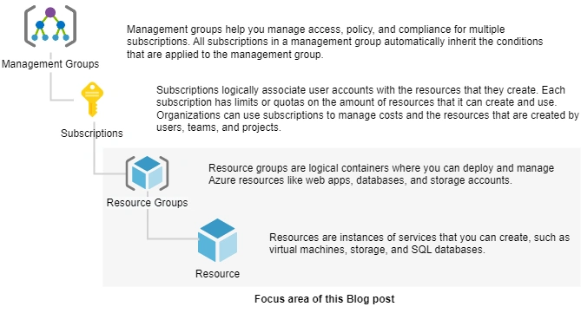
Architectural Components in Azure
What is Resource and Resource Group?
Resources can be placed in multiple resource groups but only belong to one.
Resource groups are tied to a specific Azure region.
Deleting a resource group removes all resources within it.
https://cdn.buttercms.com/JgMrYeHiSqB3XikzQK7w
Tags can be applied to resources within a group to aid in management and billing.
Simplifies RBAC implementation and policy application for resources within the same group.

Slide 7
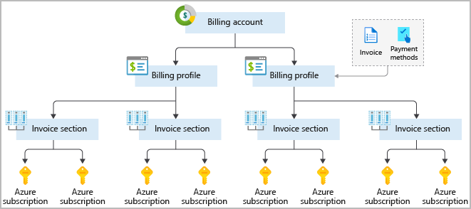
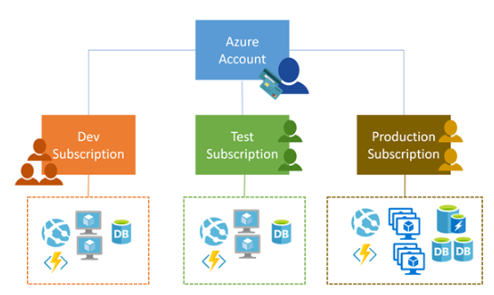
Architectural Components in Azure
What is Azure Subscriptions?
https://azurelib.com/wp-content/uploads/2021/02/image-56.png
Points to remember about Azure Subscription
Access Level
Isolation
Billing and Cost Management
Resource Organization
Limits and Quotas
https://www.websitebuilderinsider.com/wp-content/uploads/2022/08/Subscription-Type.png

Slide 8
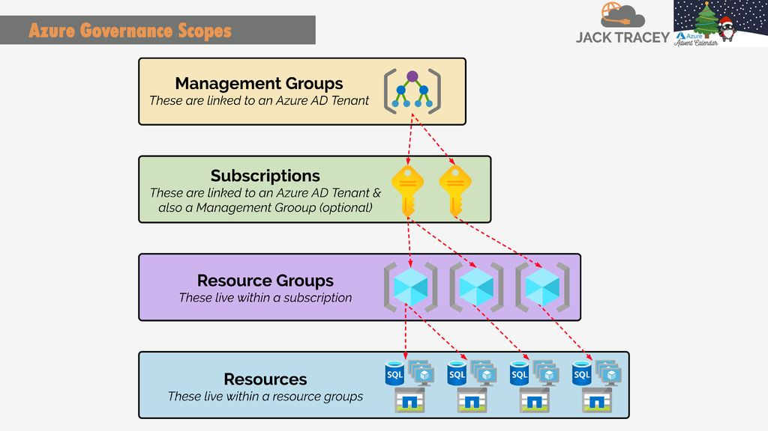
Architectural Components in Azure
What is Azure Management Groups?
Key Point about Management Group
Azure Backup and Site Recovery
Azure Automation
Azure Cost Management and Billing
Azure Resource Manager (ARM)
Azure CLI
Azure Monitor
https://slideplayer.com/slide/17816217/106/images/5/Azure+Governance+Scopes.jpg

Slide 9
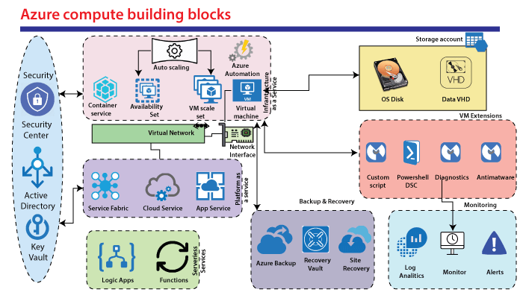
Azure Compute Services
What is Azure Compute?
Azure Compute Services offers:
Virtual Machines (VMs)
Azure App Service
Azure Functions
Azure Kubernetes Service (AKS)
Azure Batch
Azure Container Instances (ACI)
Azure Dedicated Host
https://static.javatpoint.com/tutorial/microsoft-azure/images/azure-compute-service.png
Provide VM, Serverless computing and other Computing Services

Slide 10
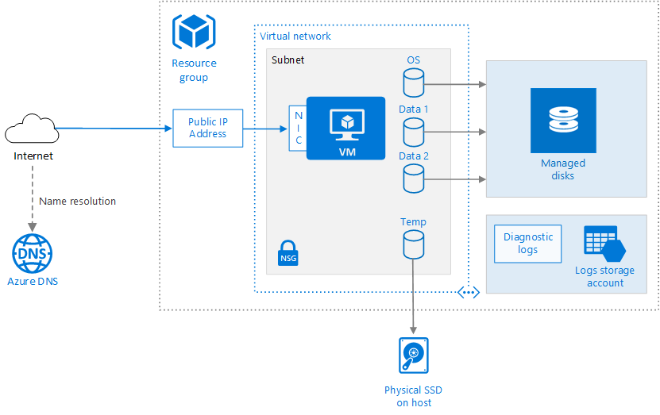
Azure Compute Services
Versatility, Fully Configurable, On Demand Scaling, Pay as you go, Availability
What is Virtual Machine in Azure?
The key elements of a Virtual Machine (VM-IaaS) in Azure include:
Image
Size
Disk Storage
Networking
Availability Sets
Extensions
Lifecycle Management
https://dotnettrickscloud.blob.core.windows.net/img/azure/az-vms1.png

Slide 11
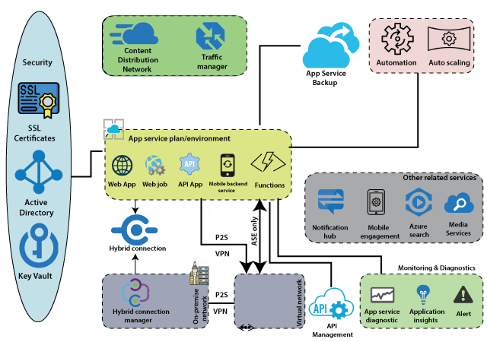
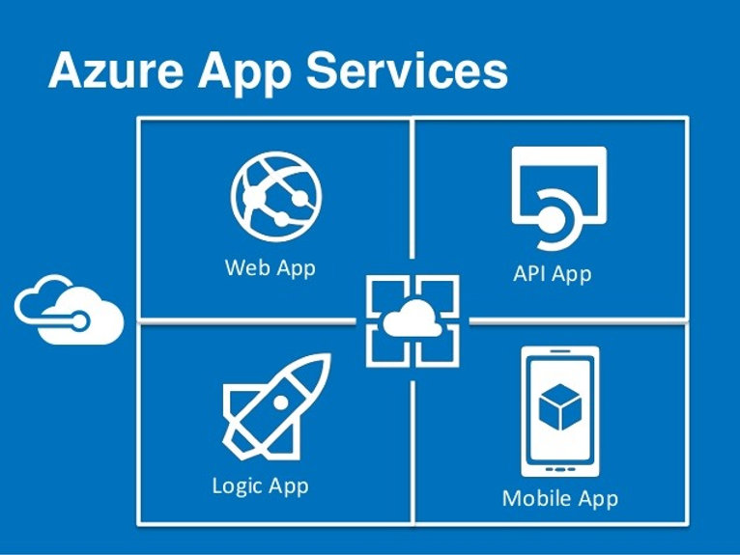
Azure Compute Services
What is Azure App Service(Host)?
https://static.wixstatic.com/media/4a43a3_43ddeb1af11a4b4094417f25a56165b5~mv2.jpg/v1/fill/w_766,h_575,al_c,lg_1,q_85/4a43a3_43ddeb1af11a4b4094417f25a56165b5~mv2.jpg
https://static.javatpoint.com/tutorial/microsoft-azure/images/azure-app-services.png

Slide 12
Azure Compute Services
Key Points to remember of Azure App Service
Web Apps
API Apps
Mobile Apps
Logic Apps
Deployment Options
Scaling and High Availability
Support for Multiple Frameworks
Integration with Azure Services
Built-in Security Feature
Monitoring and Diagnostics

Slide 13
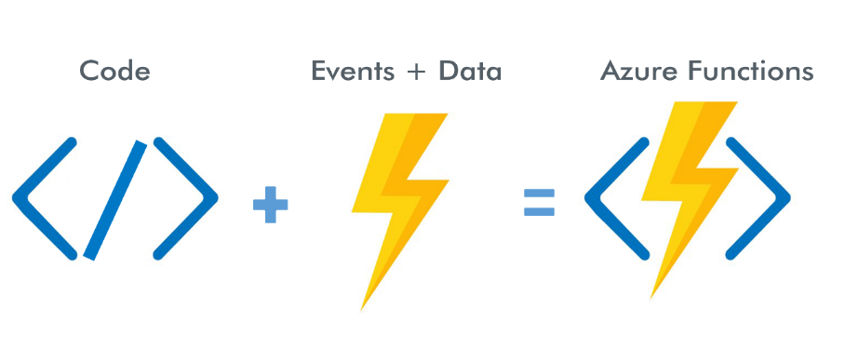
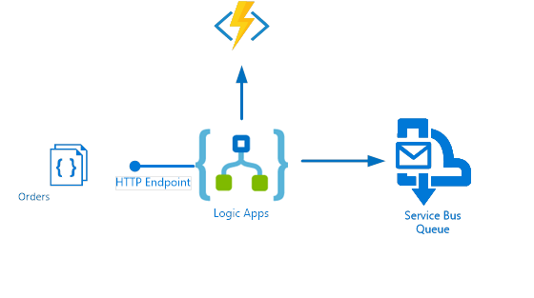
Azure Compute Services
What is Azure Functions?
Key Elements of Azure Functions:
Triggers
Bindings
Functions
Bindings Direction
Scaling
Stateless
Serverless
https://www.element61.be/sites/default/files/img_competences/2-40224.png
https://biztalk360.com/wp-content/uploads/2016/12/Use-case-scenario.png

Slide 14
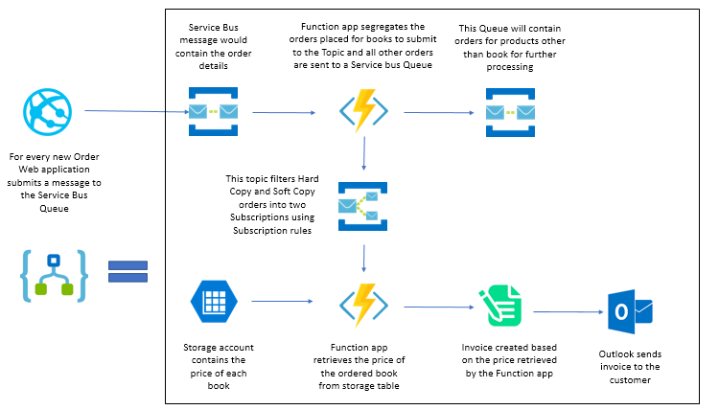
Azure Compute Services
How does Azure Function works?
https://www.serverless360.com/wp-content/uploads/2020/01/Orchestration.png

Slide 15
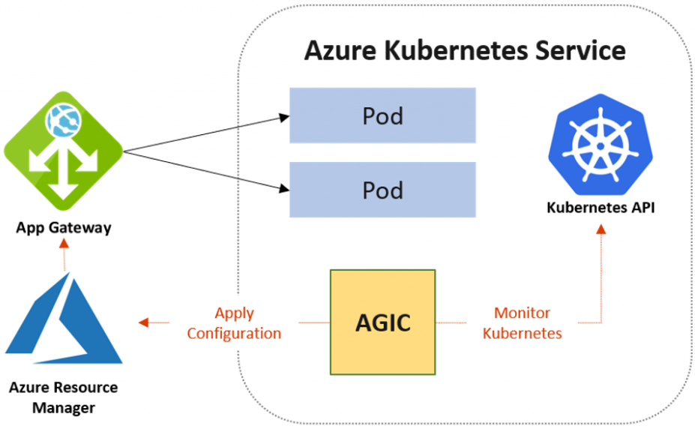
Azure Compute Services
What is Azure Kubernetes service?
Key Elements of Azure Kubernetes service:
Managed Kubernetes
Containers
Node Pools
Scaling
Integration with Azure services
Security and Identity
CI/CD Integration
Monitoring and Logging
https://www.devopsschool.com/blog/wp-content/uploads/2021/10/aks-app-gateway-1024x655.png

Slide 16
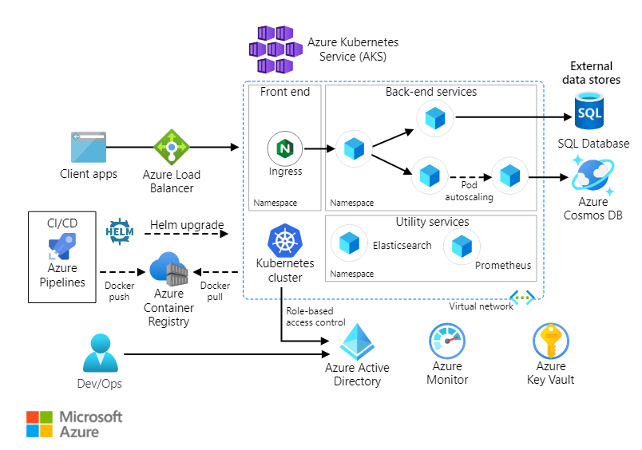
Azure Compute Services
How does Azure Kubernetes service works?
https://learn.microsoft.com/en-us/azure/architecture/reference-architectures/containers/aks-microservices/images/aks.svg

Slide 17
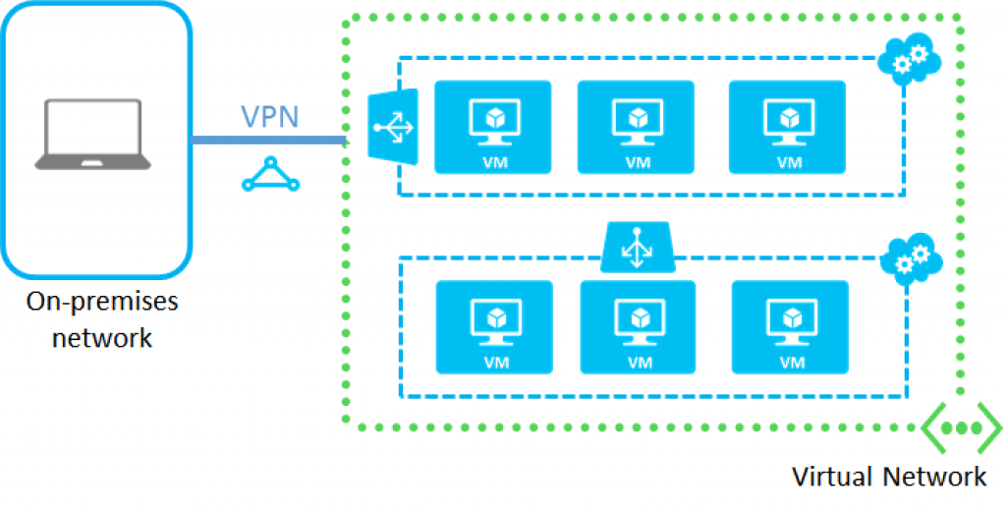
Azure Networking Services
What is Azure Virtual Network (VNet)?
Key Elements of Azure Virtual Network (VNet)
Subnets
Virtual Network Gateway
Network Security Groups
Azure DNS
Route Tables
Peering
VPN Gateway
Azure Private Link
Service Endpoints
Virtual Network TAP
https://aidanfinn.com/wp-content/uploads/2015/10/Azure-Virtual-Network-1024x522.png

Slide 18
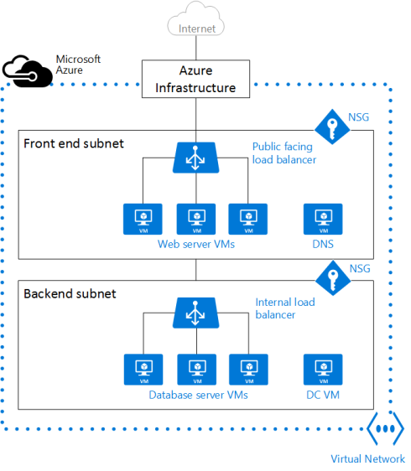
Azure Networking Services
VNet
Subnets and IP Addressing
Key Points to remember about Subnets and IP Addressing
Segmentation
Address Space
Isolation
Communication
Peering
Gateway Subnets
Naming and Addressing
Scalability
Azure Policies
https://azuretrainings.files.wordpress.com/2019/01/vnetoverview.png?w=490&h=562

Slide 19
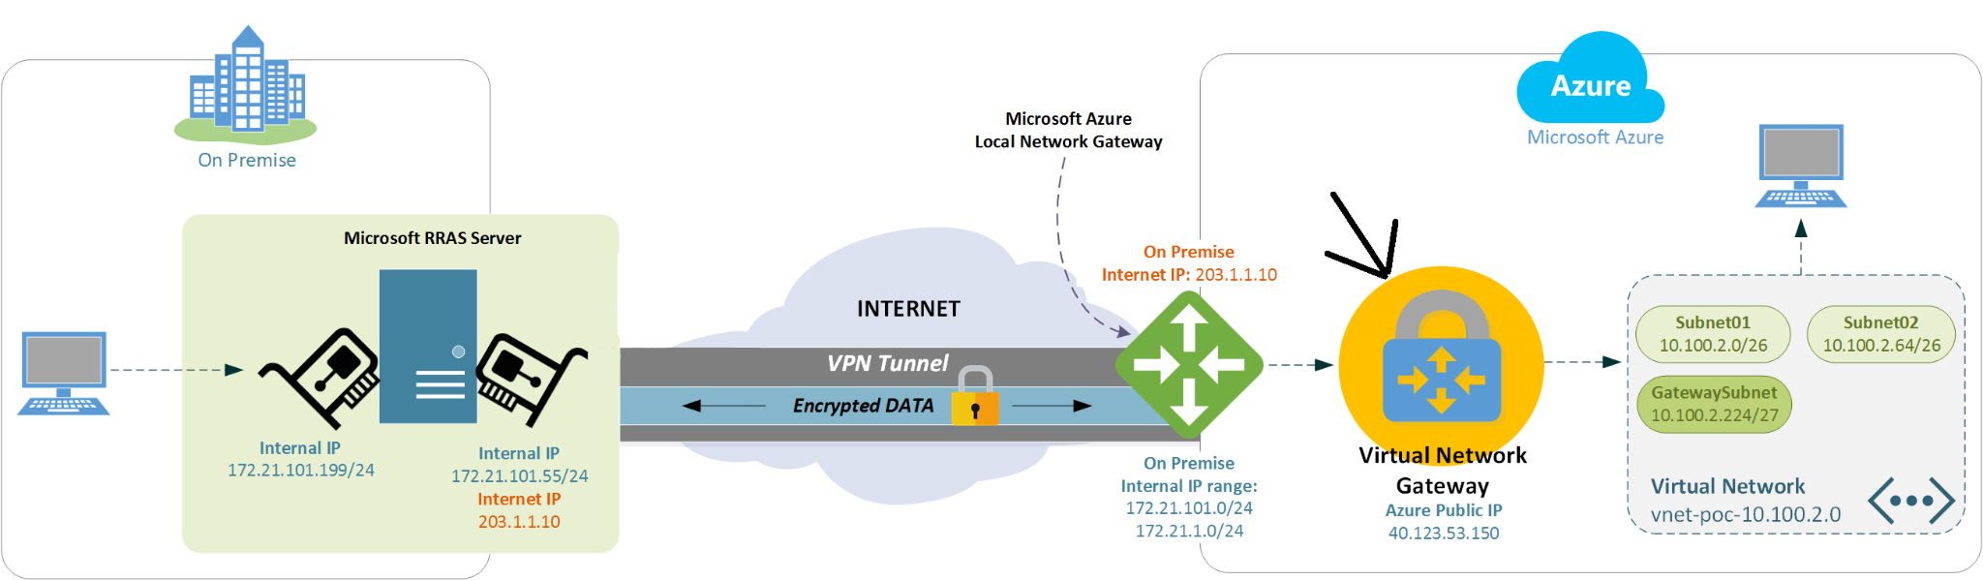
Azure Networking Services
VNet
Virtual Network Gateway
https://servergurunow.files.wordpress.com/2018/01/microsoft-azure-vpn-connection-tunnel-from-local-network-gateway-to-virtual-network-gateway.png
Key Points to remember about Virtual Network Gateway
Connectivity
VPN Types
High Availability
Scalability
Integration
Security
Configurable Routing
Monitoring and Diagnostics
Supported Protocols

Slide 20
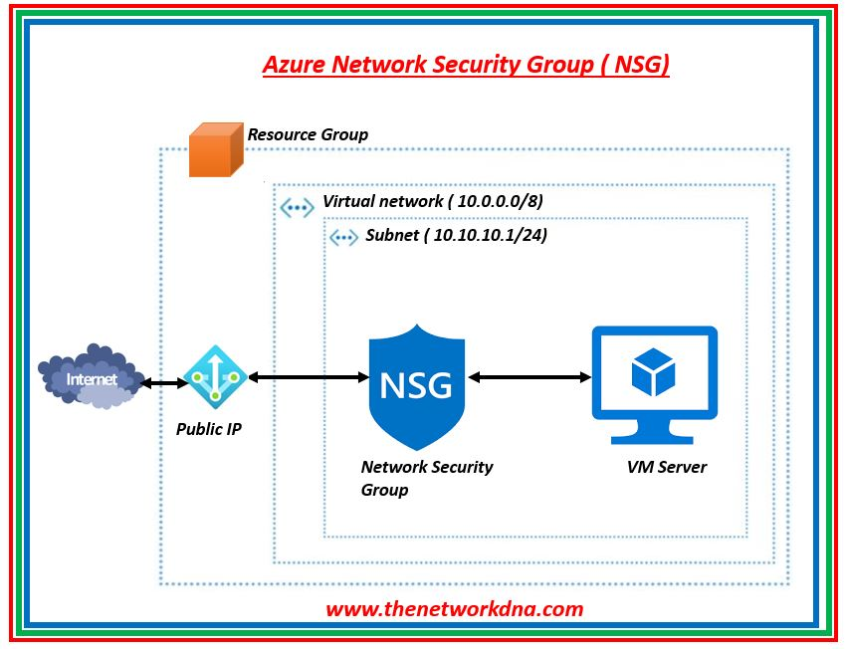
Azure Networking Services
VNet
Network Security Groups
Key Points to remember about Network Security Groups
Traffic Filtering
Rule Prioritization
Rule Configuration
Default and Custom Rules
Security Enforcement
Subnet Association
Effective Security
Stateful Inspection
Monitoring and Logging
Access Control
https://blogger.googleusercontent.com/img/b/R29vZ2xl/AVvXsEi9Ouf1pRALPyrSzlVuQUHSH9Jr-vSVITlWIaJV-8Ai8vm-3f7ERrGA7XIXAOl50neE0fj5KtHD9CaN2mjYgTSKm0AtM58Z8eICtu_H9nI3Zt4x14NSkIIcqUhAZccB2tbpoaP94lJdOZgGbOaXD6DvcyRtBvFAG9jjMJgD3Hm0hOHz-ZbQM-ozEymn9Q/s849/Azure1.JPG

Slide 21
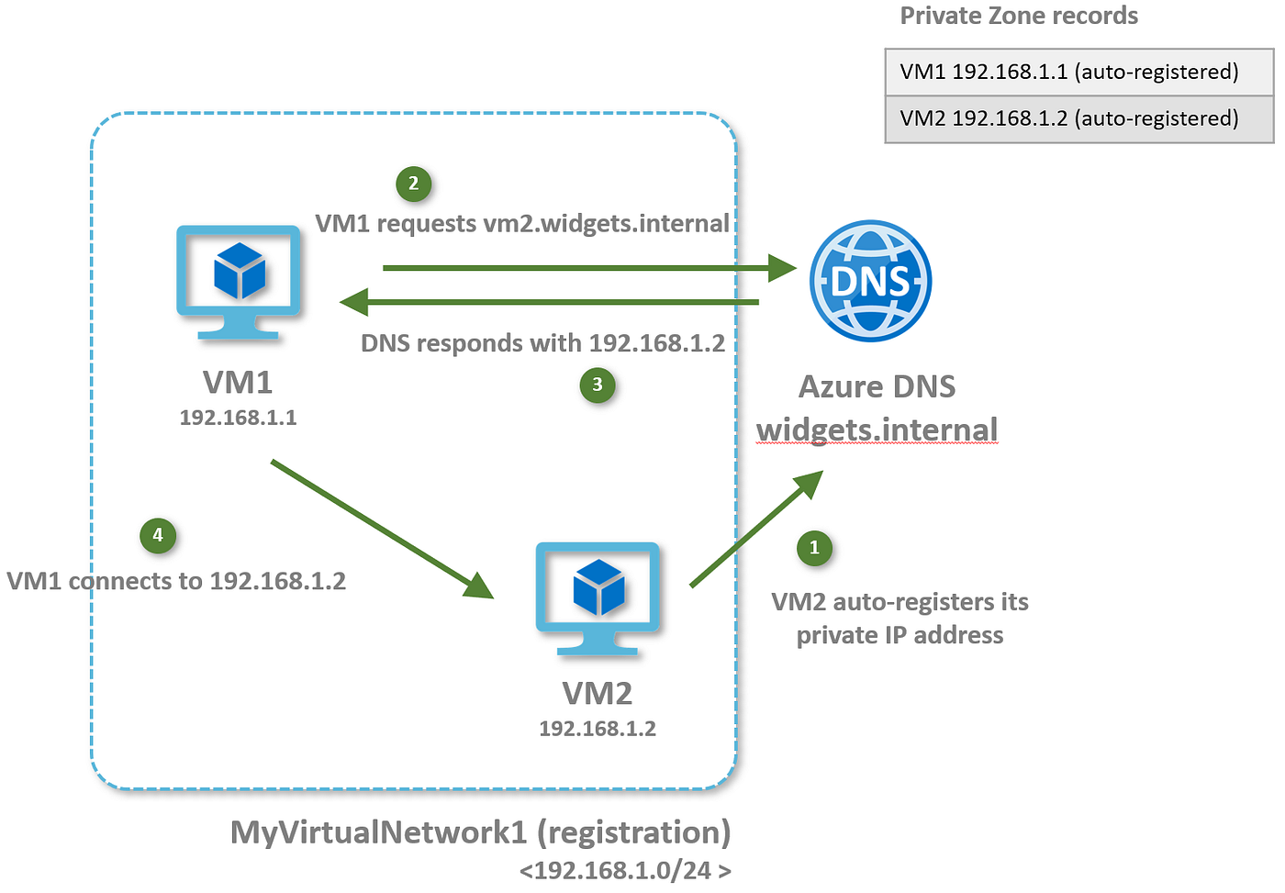
Azure Networking Services
VNet
Azure DNS and Network Resolution
Key Points to remember about Azure DNS
Domain Hosting
Domain Resolution
Public and Private Zones
Integration with VNets
Name Resolution from On-Premises
DNS Security
Traffic Routing
https://miro.medium.com/v2/resize:fit:1400/1*Y1cHoqLfRdFzeuOTLewucA.png

Slide 22

Azure Networking Services
VNet
Virtual Network Peering and Connectivity
https://learn.microsoft.com/en-us/azure/virtual-network/media/virtual-networks-peering-overview/local-or-remote-gateway-in-peered-virual-network.png

Slide 23
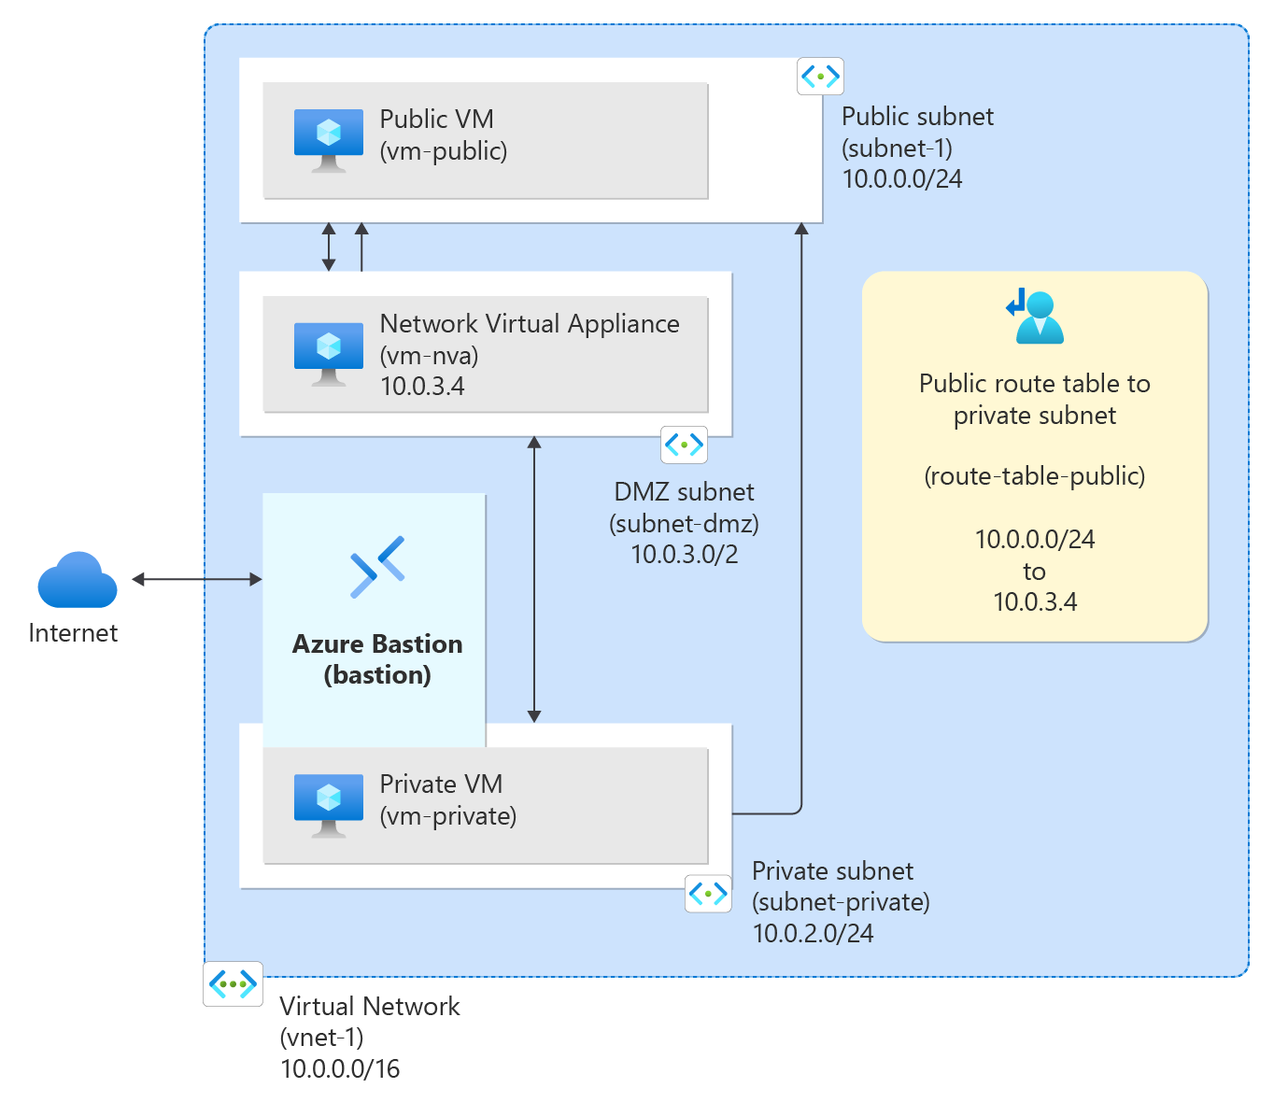
Azure Networking Services
VNet
Routing and Traffic Control
https://learn.microsoft.com/en-us/azure/virtual-network/media/tutorial-create-route-table-portal/resources-diagram.png

Slide 24
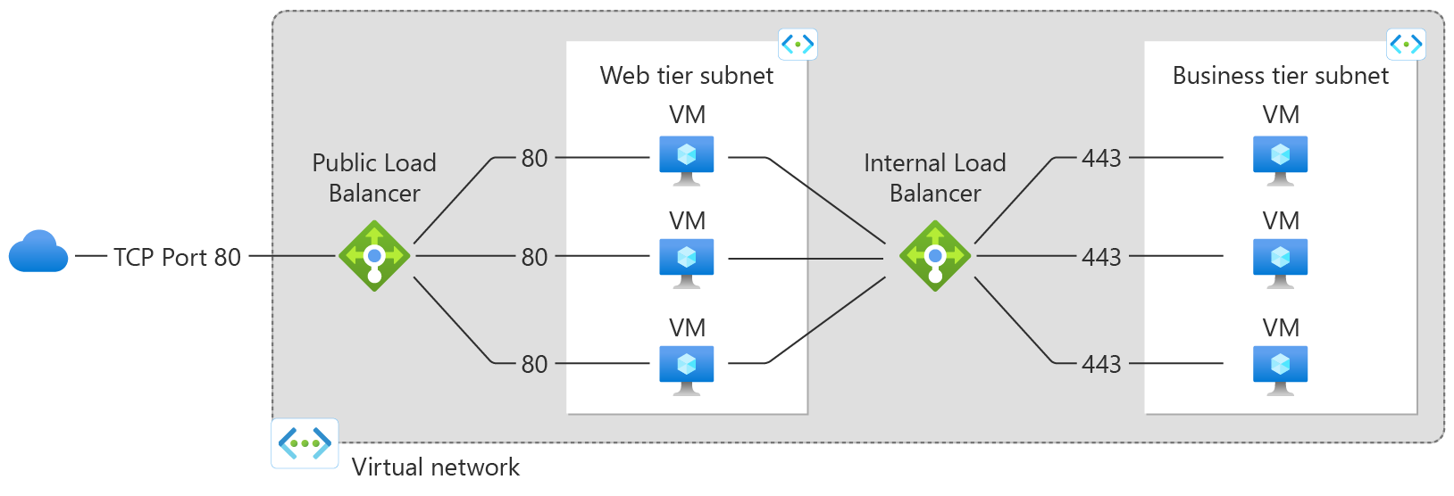
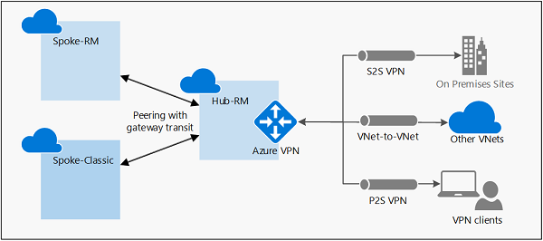
Azure Networking Services
Azure Load Balancer
https://learn.microsoft.com/en-us/azure/load-balancer/media/load-balancer-overview/load-balancer.png
Azure VPN Gateway
https://learn.microsoft.com/en-us/azure/vpn-gateway/media/vpn-gateway-peering-gateway-transit/gatewaytransit.png

Slide 25
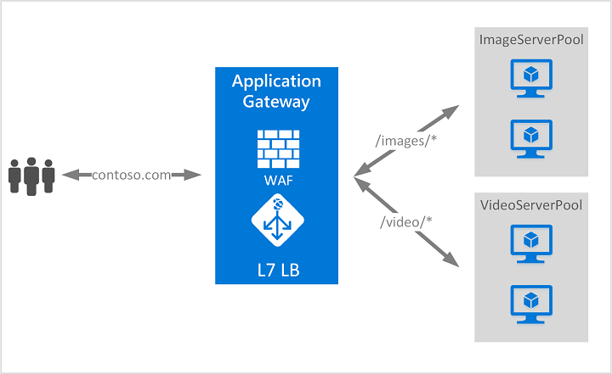
Azure Networking Services
Azure Application Gateway
https://learn.microsoft.com/en-us/azure/application-gateway/media/application-gateway-url-route-overview/figure1-720.png

Slide 26
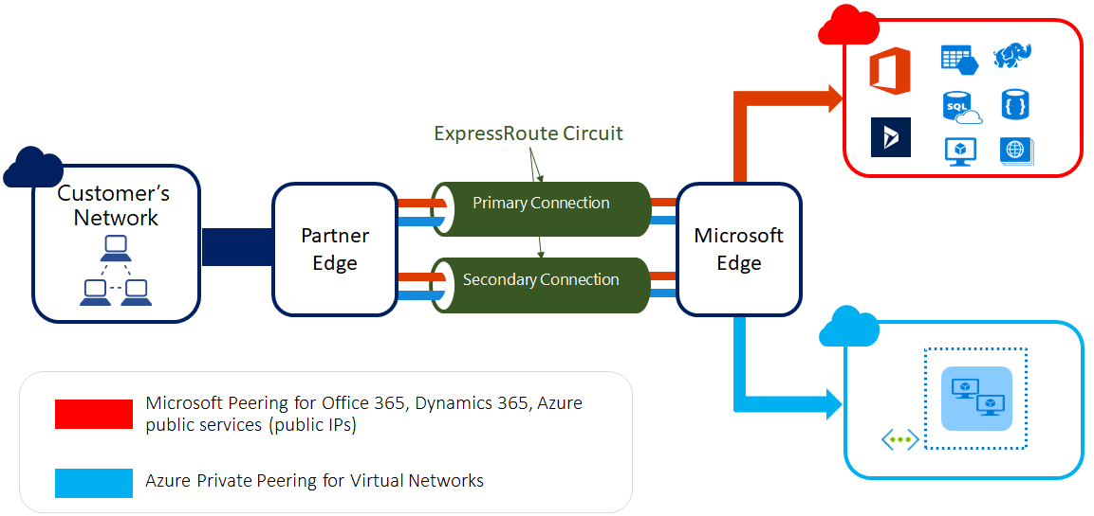
Azure Networking Services
Azure Express Route
Key Points to remember about Azure Express Route
Dedicated Connection
Enhanced Security
Predictable Performance
Various Connectivity Models
Global Reach
Layer 3 Connectivity
Private Connectivity to Azure Services
Bandwidth Flexibility
https://learn.microsoft.com/en-us/azure/expressroute/media/expressroute-introduction/expressroute-connection-overview.png

Slide 27
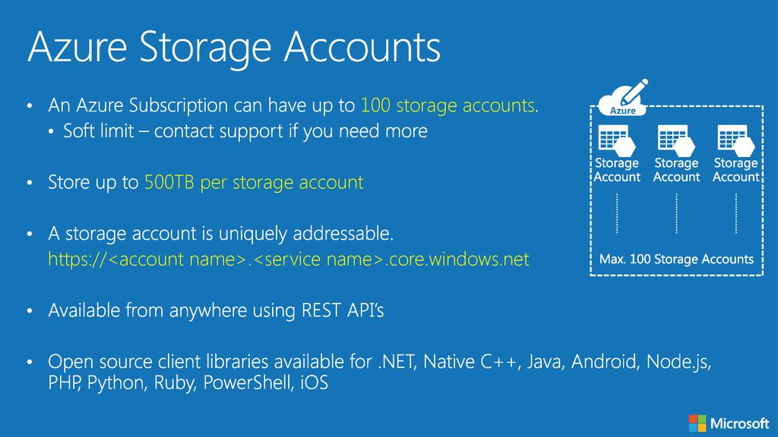
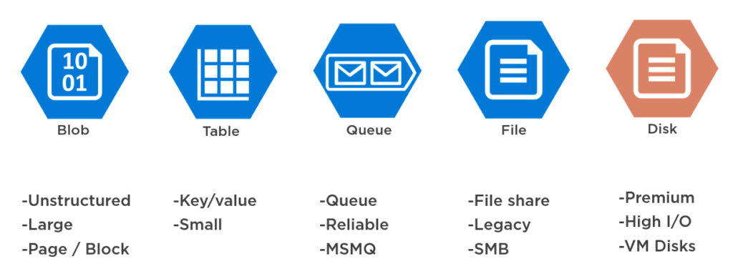
Azure Storage Services
What is Azure Storage Services?
https://slideplayer.com/slide/14140091/86/images/6/Azure+Storage+Accounts.jpg
https://mostafaelmasry.files.wordpress.com/2020/04/azure-storage-account.png?w=1024

Slide 28
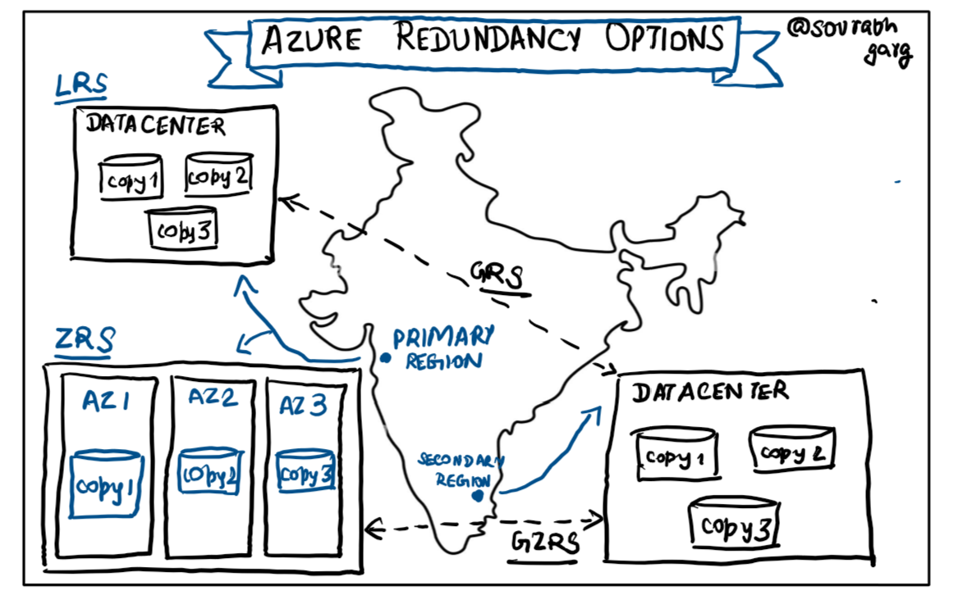
Azure Storage Services
Redundancy Options in the Primary Region and Secondary Region
Primary Region
Locally Redundant Storage (LRS)
Zone-Redundant Storage (ZRS)
Secondary Region
Geo-Redundant Storage (GRS)
Geo-Zone-Redundant Storage (GZRS)
https://miro.medium.com/v2/resize:fit:1184/1*0sCp2vxsBBZOCOG7gmMPPw.png

Slide 29
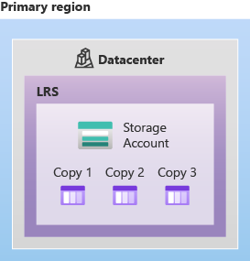
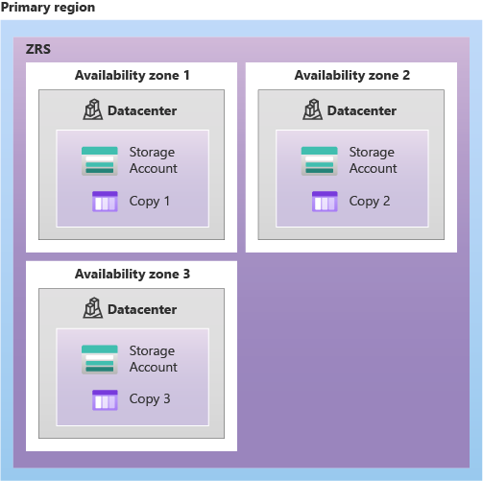
Azure Storage Services
Primary Region
Zone-Redundant Storage (ZRS):
Replicates data synchronously across three Azure availability zones.
Offers durability of at least 12 nines (99.9999999999%) over a year.
Ensures data accessibility even if a zone becomes unavailable.
Locally Redundant Storage (LRS):
Replicates data three times within a single data center.
Provides at least 11 nines (99.999999999%) of durability over a year.
Low-cost option but offers less durability compared to others.
Ref

Slide 30
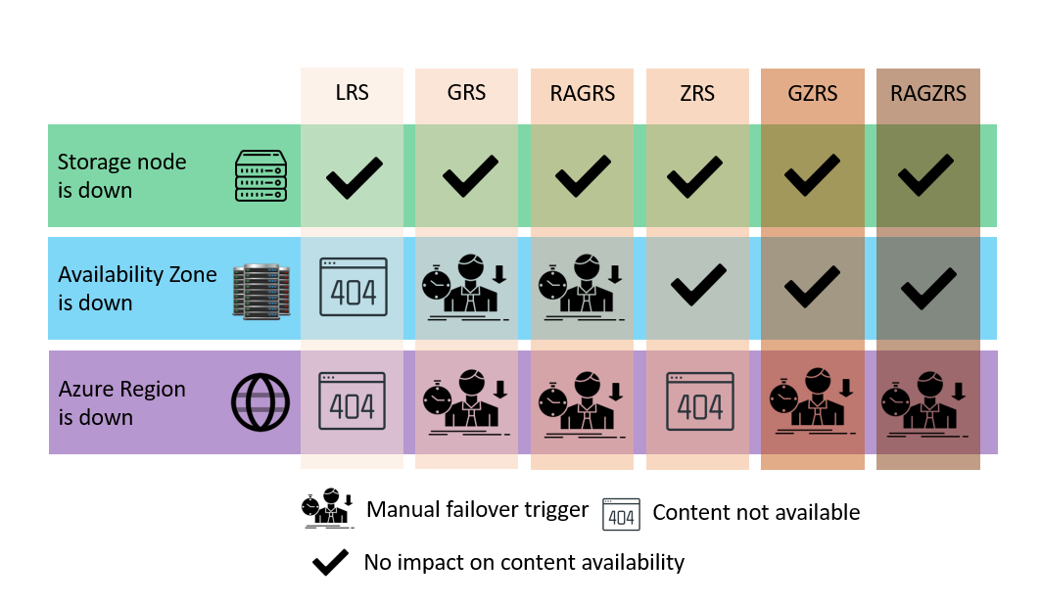
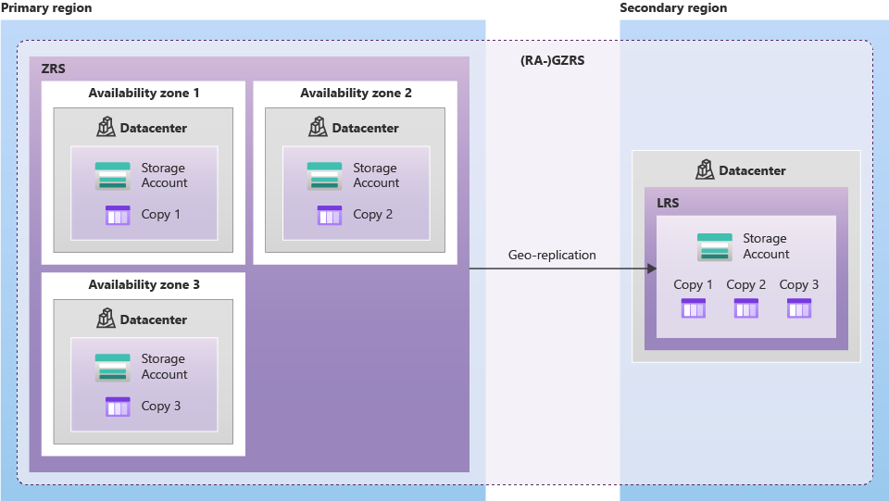
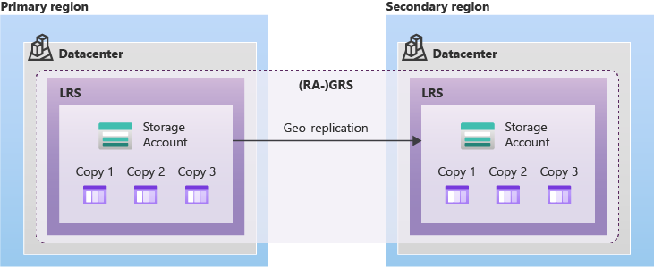
Azure Storage Services
Secondary Region
Ref
Ref
Ref

Slide 31
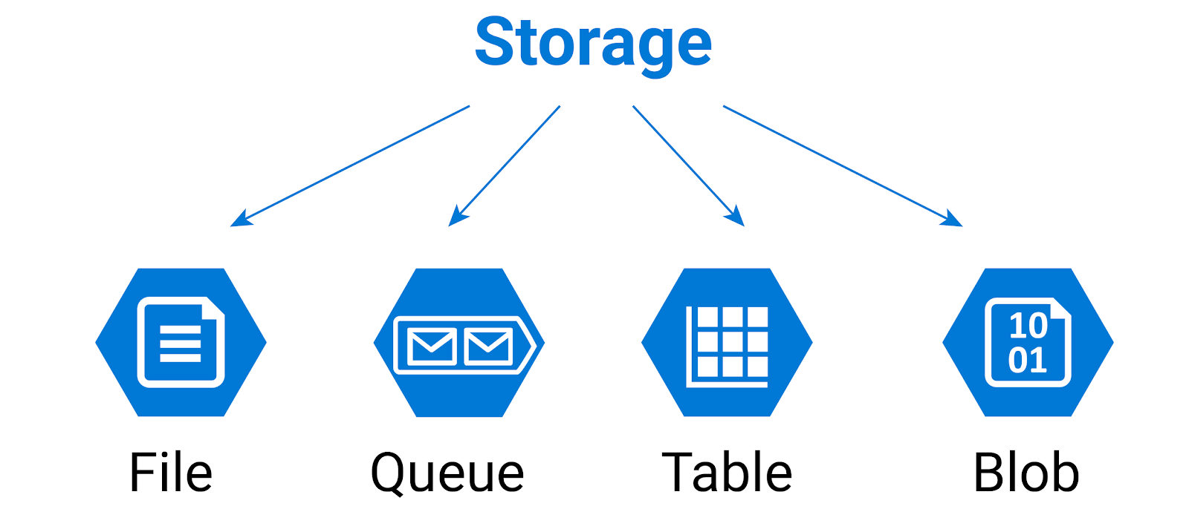
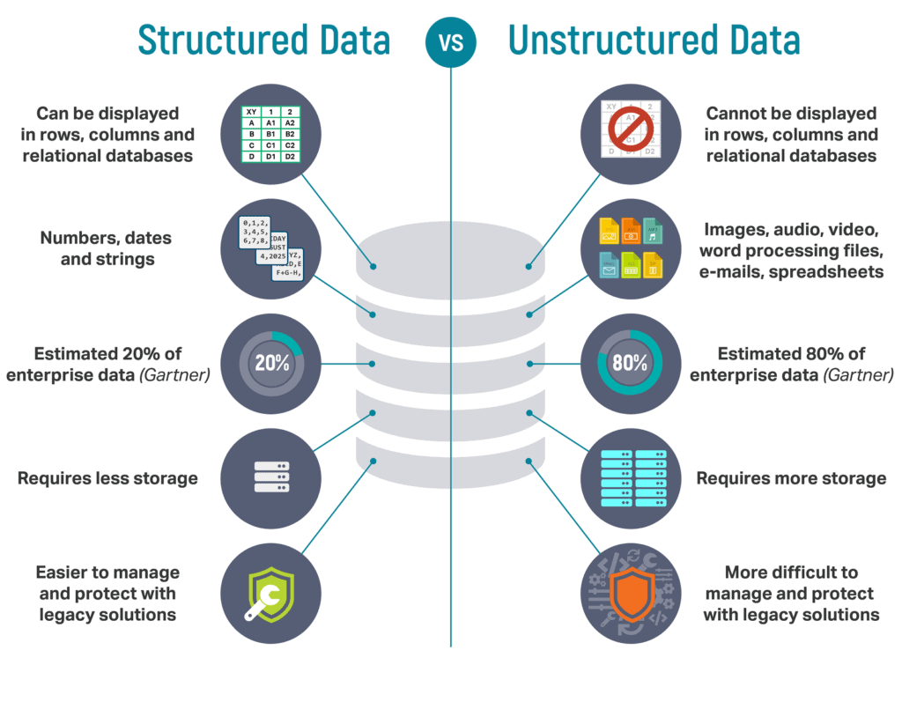
Azure Storage Services
What is are different storage services provided by azure?
https://luismts.com/wp-content/uploads/2023/08/azure-storage1.png
Types of Storage account
https://k21academy.com/wp-content/uploads/2020/10/structured-data-vs-unstructured-data.png

Slide 32
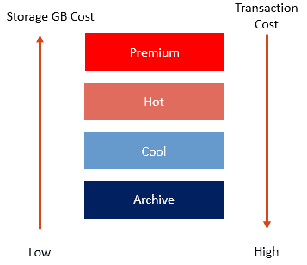
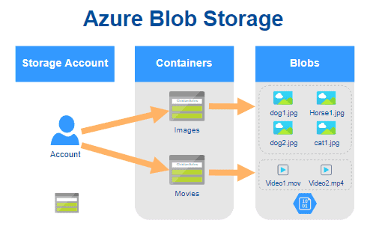
Azure Storage Services
What is Azure Blob Storage?
Points to Remember about Azure Blob Storage
Unstructured Data Storage
Versatile Use Cases
Accessible and Scalable
Storage Tiers
Redundancy and Durability
Pricing and Security
https://davidalzamendi.com/wp-content/uploads/2020/08/image-6.png
Azure Blob Storage provides multiple storage tiers to manage data.
https://blog.christian-schou.dk/content/images/2022/09/quick-introduction-to-azure-blob-storage.png

Slide 33
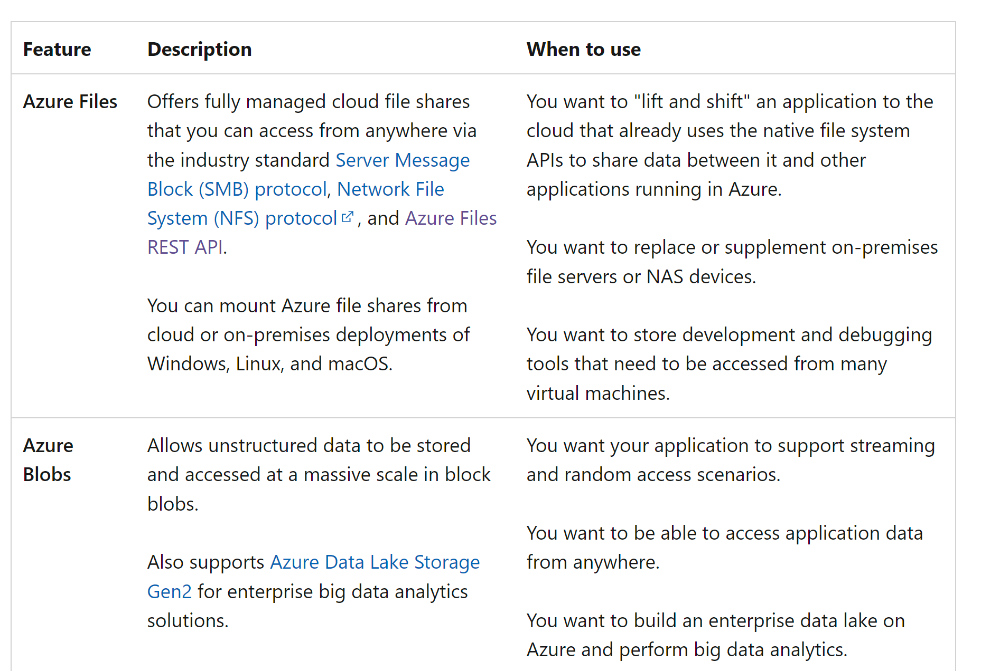
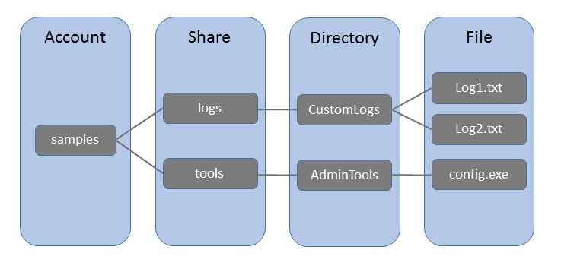
Azure Storage Services
What is Azure File Storage?
https://petri-media.s3.amazonaws.com/2015/10/AzureFiles-concepts.png
https://i.stack.imgur.com/C1v53.png

Slide 34
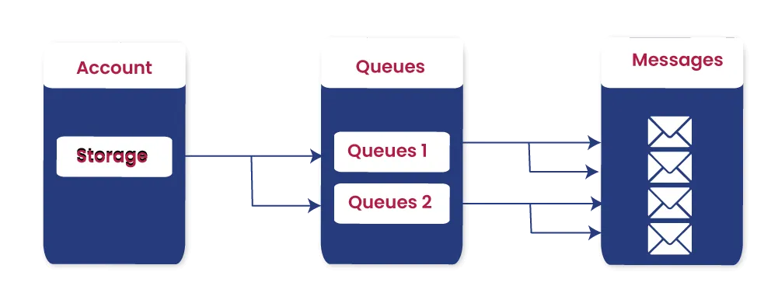
Azure Storage Services
What is Azure Queue Storage?
Points to be remember about Azure Queue Storage
Message Queues
Decoupling Components
Message Lifecycle
Scalability and Performance
Security
Monitoring and Logging
Cost-Efficiency
SDKs and Integration
Guaranteed Delivery
Message Size Limitation
https://futransolutions.com/wp-content/uploads/2023/05/Structure-of-Azure-Queue-Storage.png

Slide 35
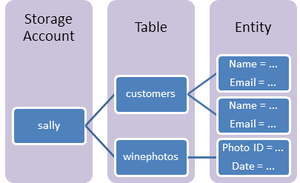
Azure Storage Services
What is Azure Table Storage?
Points to be remember about Azure Table Storage
NoSQL Structure
Schema-less Design
Partition and Row Keys
Scalability
Performance Considerations
Querying with Partition and Row Keys
Storage Types
Consistency Levels
SDK Support
Access Control and Security
Billing Model
Backup and Recovery
https://learn.microsoft.com/en-us/azure/includes/media/storage-table-concepts-include/table1.png

Slide 36
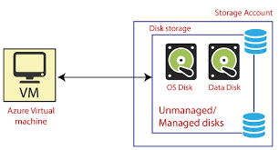
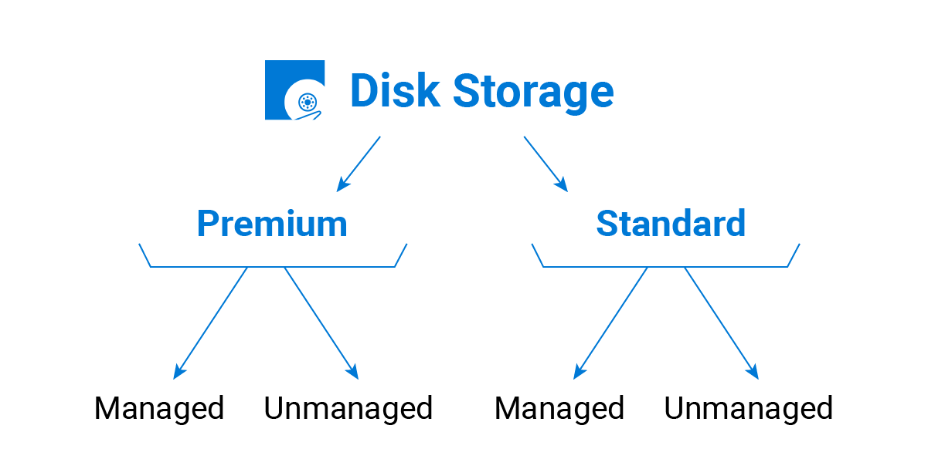
Azure Storage Services
What is Azure Disk Storage?
Points to Remember about Azure Disk Storage
Types of Disks
Performance Tiers
Redundancy and Availability
Snapshots and Backups
Scaling and Performance Tuning
Managed Disk Service
Security and Encryption
Monitoring and Management
https://static.javatpoint.com/tutorial/microsoft-azure/images/azure-disk-storage.png
Types of Azure Disk Storage
Ref

Slide 37
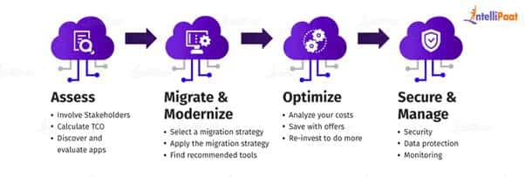
Identify Azure Data Migration Options
What is Azure Migration?
Azure offers several data migration options to efficiently move your data to the cloud:
Azure Data Box
Azure Data Box Disk
Azure Data Box Heavy
Azure Site Recovery
Azure Database Migration Service
Azure Data Migration Assistant
Azure Data Factory
Online data transfer
Azure Data Sync
https://intellipaat.com/blog/wp-content/uploads/2022/07/Azure-Migration-Process.jpg

Slide 38
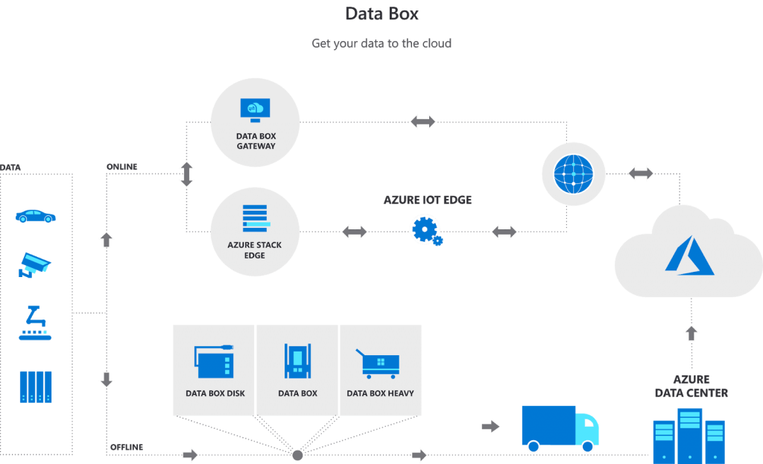
Azure Data Box
What is Azure Data Box?
https://n9c5x7a8.rocketcdn.me/wp-content/uploads/2020/10/image-57-1024x623.png

Slide 39

Azure SQL
What is Azure SQL?
Points to remember about Azure SQL Database
Scalability
Security Features
High Availability
Compatibility
Managed Service
Elastic Pools
Performance Monitoring
Geo-Replication
Advanced Analytics
Cost Management
https://static.javatpoint.com/tutorial/microsoft-azure/images/azure-database-service.png

Slide 40

Azure SQL
SQL Managed Instance
Compatibility and Isolation
Fully Managed Service
Flexible Deployment Options
Network Isolation and VNet Support
High Availability and Disaster Recovery
Compatibility and Migration
Security Features
https://learn.microsoft.com/en-us/azure/azure-sql/managed-instance/media/sql-managed-instance-paas-overview/application-deployment-topologies.png?view=azuresql

Slide 41

Azure SQL
Elastic Pools
Resource Sharing
Cost Optimization
Performance and Scalability
Resource Governance
Isolation and Flexibility
Scaling and Management
Consistent Database Management
Cost Predictability
https://www.dotnetcurry.com/images/azure/sql-azure-elastic-saas/elastic-architecture.png

Slide 42
Thank You.

